Slide 1

SOFTWARE DESIGN AND ANALYSIS FINAL PROJECT
EduCore
Your All-in-One Student Management System for Modern Education
www.educore.pk

Slide 2


Purpose:
The Student Management System streamlines academic and administrative tasks, making student management efficient and organized.
This system integrates key functionalities like a Communication Portal, GPA Calculator, Timetable Management, and Assignment Submission. Users can view and add students, manage courses, and submit feedback seamlessly, ensuring efficiency and improved collaboration for educational institutions.

Slide 3








Layered Architechture and Project Flow
CLIENT
Controller Layer
Service Layer
Repository Layer
Entity Layer

Slide 4


GoF Patterns Used
1
Factory Pattern: Automates repository creation with Spring. JPA provides runtime implementations seamlessly.
2
Singleton Pattern: Spring's dependency injection ensures beans like StudentService and StudentRepository are singletons by default, enabling the same instance to be used across the application.
3
Adapter Pattern: JPA serves as an adapter between the Java object model and relational database systems, ensuring smooth integration.

Slide 5

Low Coupling
High Cohesion
Pure Fabrication
Information Expert
CONTROLLER
CREATOR
Handles HTTP requests and delegates responsibilities to the service layer for processing.
Spring handles object creation and dependency injection for controllers, services, and repositories.
Controllers, services, and repositories are loosely coupled, focusing only on their specific roles.
Each class has a clear responsibility: controllers for requests, services for logic, and repositories for database interaction.
The service layer organizes business logic and reduces coupling without directly mapping to domain entities.
Model Classes
Repositories
Service Layer
Objective 4

Slide 6





Functionalities Included
Communication Portal
GPA Calculator
Timetable Management
View Students
Add Students.
Courses
Add Assignement
Submit Feedback

Slide 7
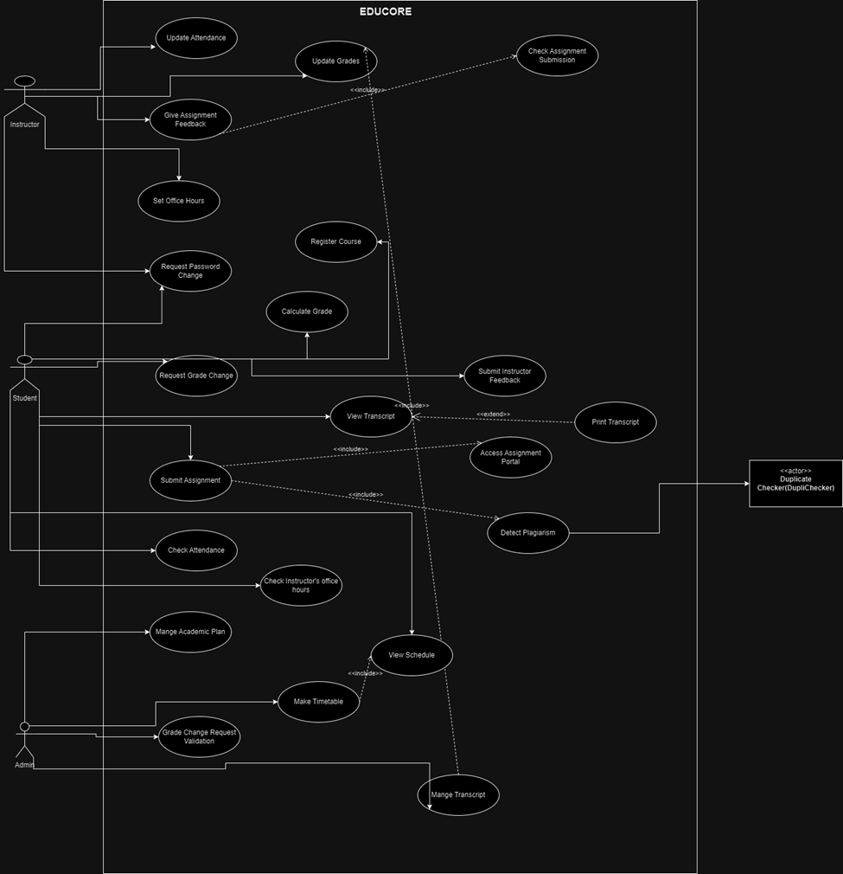

Use Case Diagram:

Slide 8
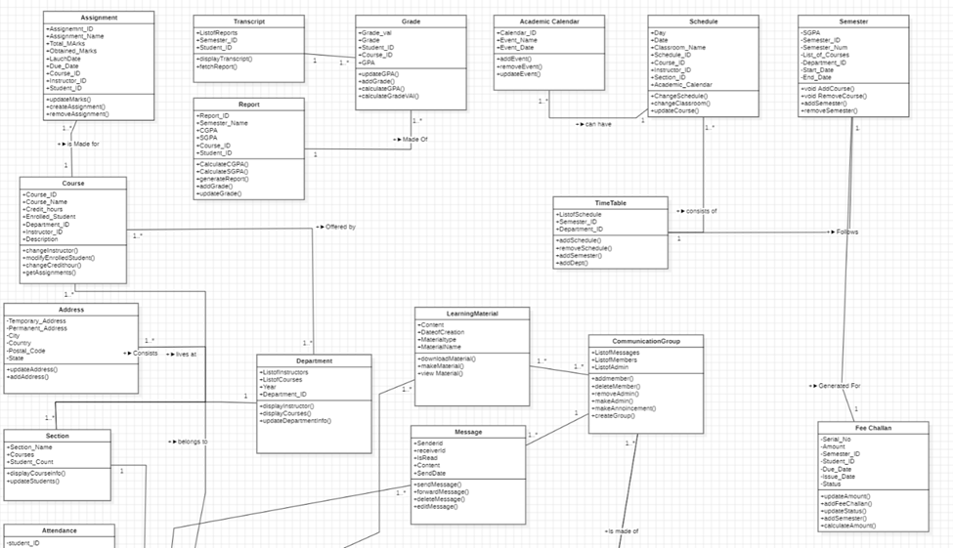
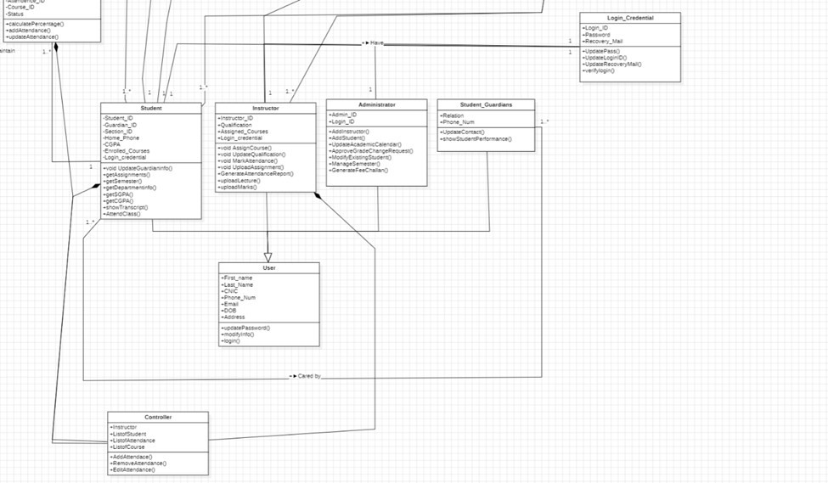
Class Diagram:

Slide 9
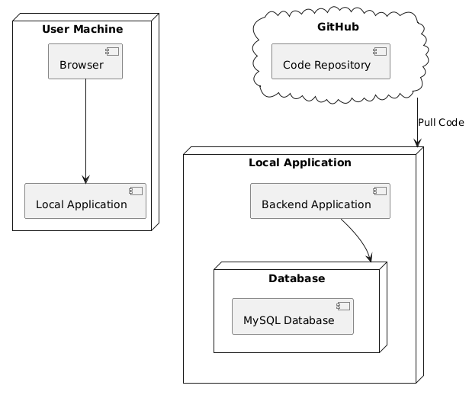
Deployment Diagram:

Slide 10

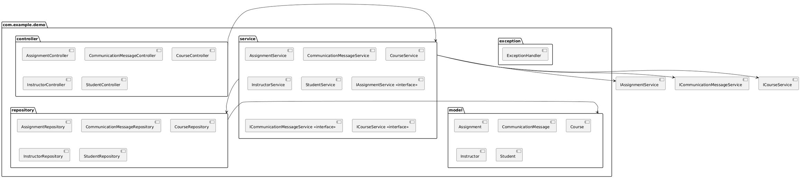
Component Diagram:

Slide 11
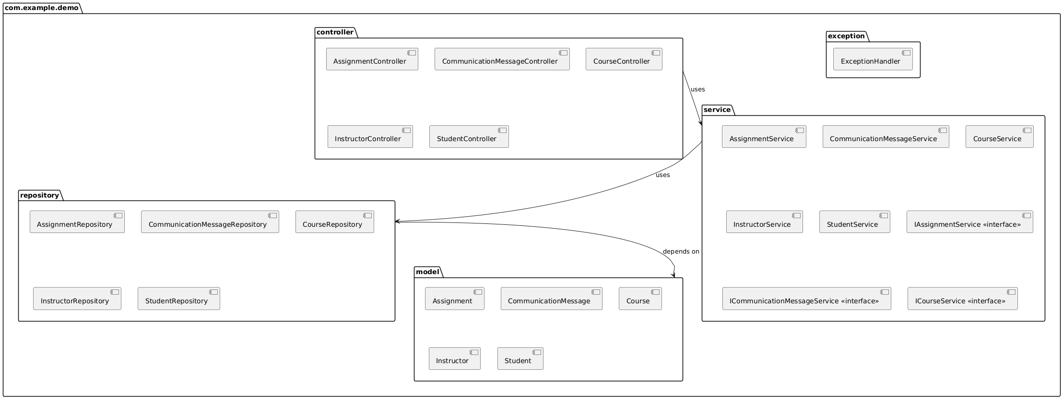
Package Diagram:

Slide 12
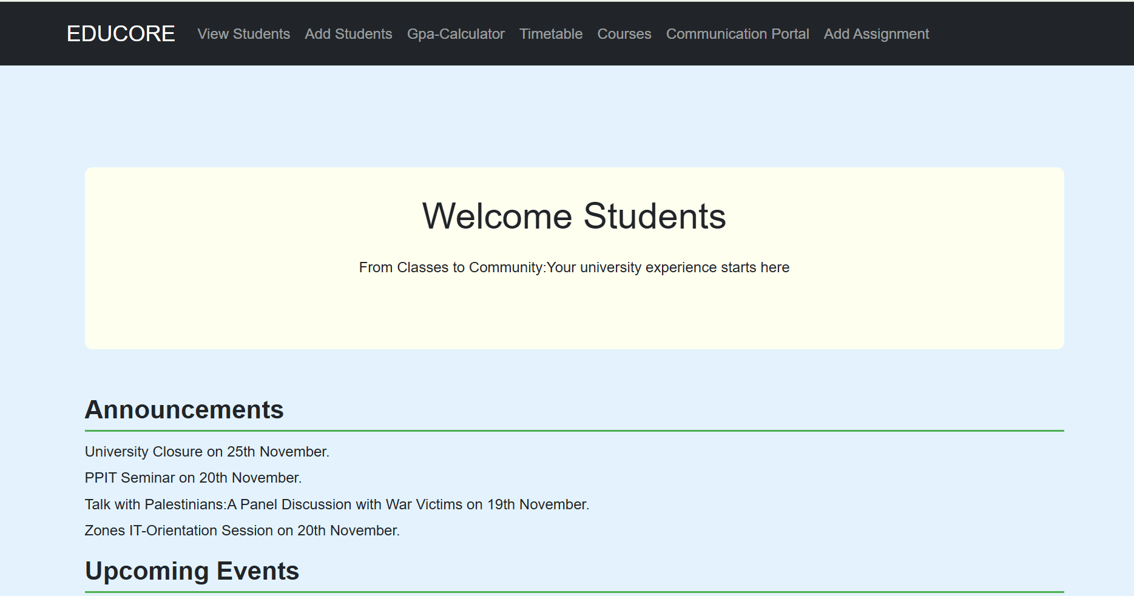
Application Demo
Interface

Slide 13
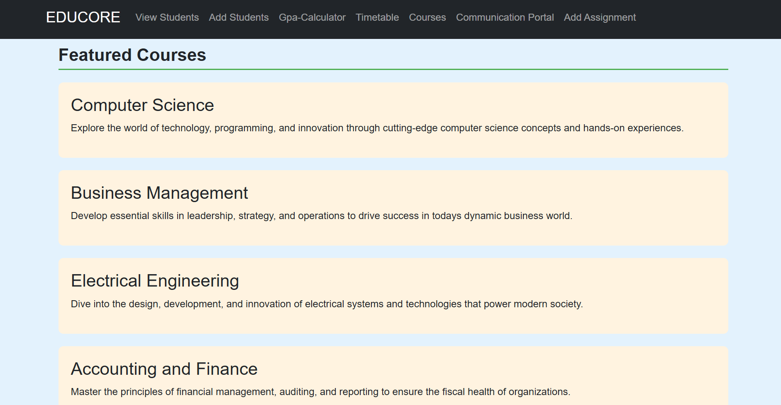

Slide 14
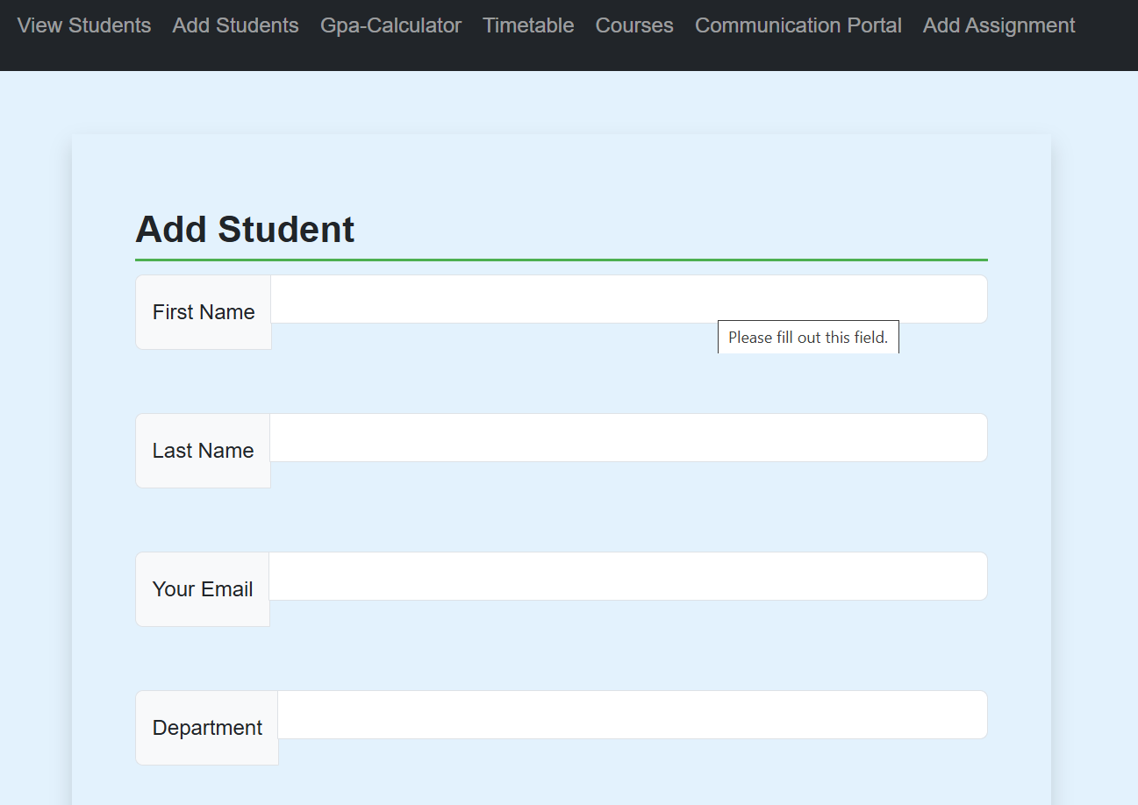
Add Students:

Slide 15
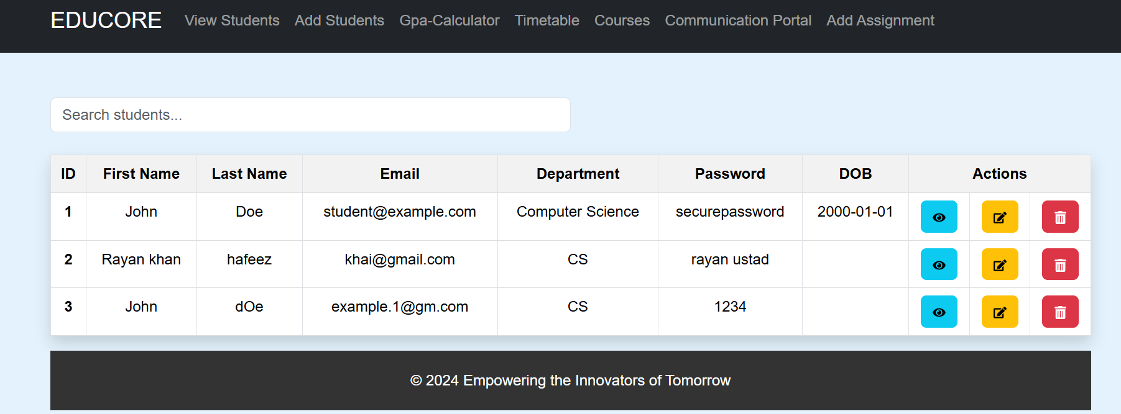
View Students:

Slide 16
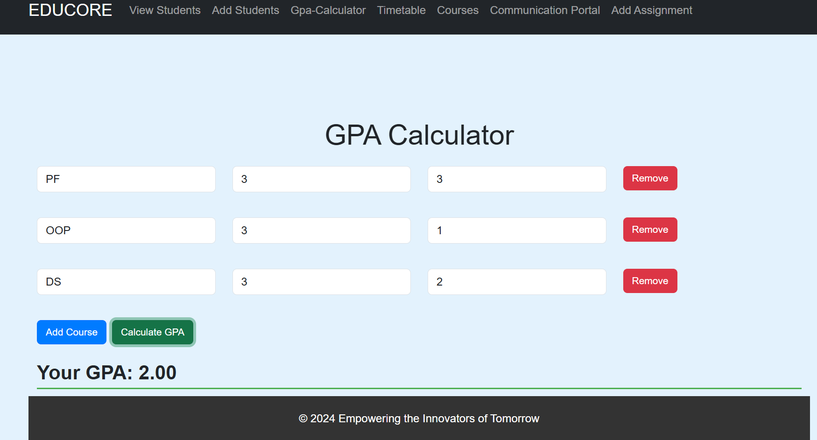
GPA Calculator:

Slide 17
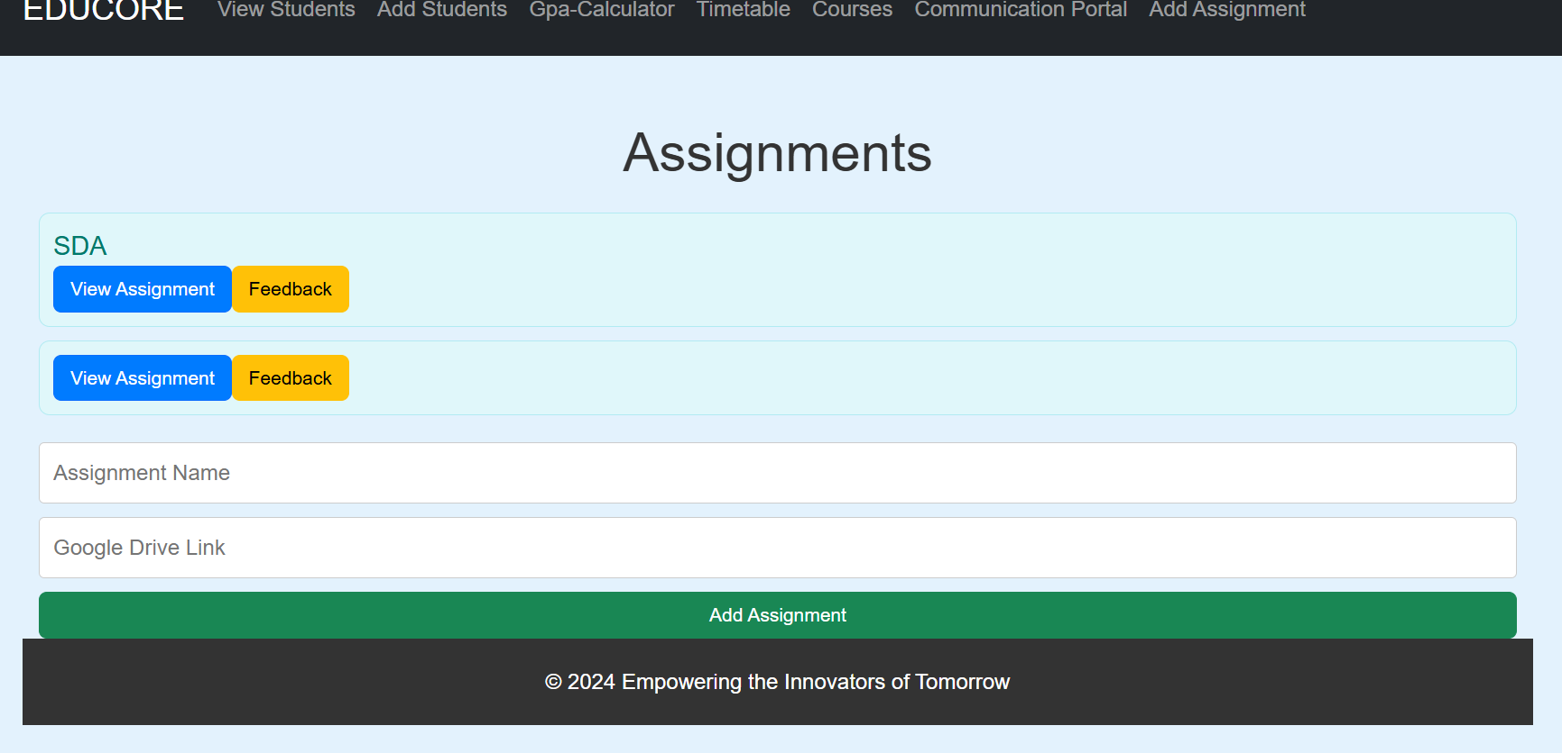
Assignment Submission and Feedback:

Slide 18

Thank You

